Slide 1

CENTURION UNIVERSITY OF TECHNOLOGY AND MANAGEMENT
APPLIED DATA SCIENCE PROJECT
Smart Guard: Facial Security Alert System
SUBMITTED BY:
M. SASI REKHA 211801380037
T.K.L NANDITHA 211801380033
I.NIHARIKA 211801380027
T.CHARISHMA 211801380010
SUBMITTED TO:
Mr. Amit Kumar
Asst Professor

Slide 2
ABSTRACT
Facial recognition technology is becoming increasingly popular in security systems, as it offers a more secure and convenient way to authenticate users. Facial security alert system that aims to improve the accuracy and reliability of facial recognition technology for security applications. The system is designed to continuously monitor a secure area and automatically generate alerts when an unauthorized or suspicious individual is detected. These alerts can be sent to security personnel or authorities for further action, ensuring a quick response to potential security threats. Overall, this system offers a powerful and reliable tool for improving security measures and protecting sensitive information, making it a valuable asset for any organization looking to enhance their security protocols.

Slide 3
INTRODUCTION
This face recognition security alert system can automatically detect and alert authorities of any unauthorized individuals attempting to gain access to restricted areas.
This real-time monitoring can help prevent security breaches and enhance overall safety.
The AI-based face recognition system can store and analyze data on individuals, enabling better tracking and monitoring of suspicious activities.

Slide 4
COMPONENTS
Software Components Requirements
Jupyter NotJupyter Notebook
Hardware Components Requirements
Processor - Intel Core Duo 2 GHz
RAM - 2 GB Minimum Ram Required
OS - Windows 7 or Later
Web Camera

Slide 5
EXISTING SYSTEM
Traditional security systems such as locks and keys are no longer sufficient in preventing unauthorized access to sensitive areas.
As a result, one such solution is the use of artificial intelligence (AI) based security alert systems using face recognition technology.
Disadvantages :
Lack of Remote Monitoring
Lack of Integration
Limited Customization

Slide 6
PROPOSAL SYSTEM
An AI-based security alert system using face recognition and message generation would involve using facial recognition technology to identify individuals in a specific area.
When an unauthorized person is detected, the system would automatically generate a security alert message that would be sent to e- commerce application or security officials.
Advantages :
Improved Security
Quick Response
Reduced Human Error

Slide 7
IMPLEMENTATION OF CODE
# color images
import cv2
import os
import face_recognition
# Open the video capture
video = cv2.VideoCapture(0)
# Load the face detection classifier (not used in face_recognition)
# facedetect = cv2.CascadeClassifier("haarcascade_frontalface_default.xml")
# Get user ID
id = input("Enter Your ID: ")
# Create a directory for the person (if it doesn't exist)
person_dir = 'DATASET/' + str(id)
os.makedirs(person_dir, exist_ok=True)
count = 1
while True:
# Read a frame from the video
ret, frame = video.read()
# Detect faces using face_recognition library
face_locations = face_recognition.face_locations(frame)
for (top, right, bottom, left) in face_locations:

Slide 8
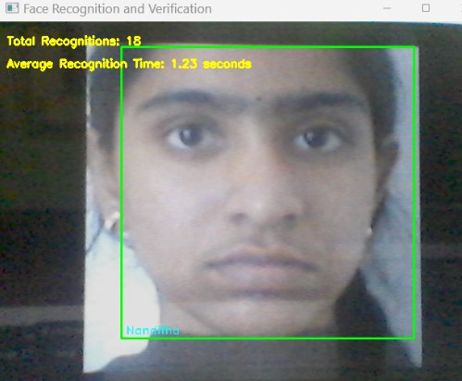

Slide 9
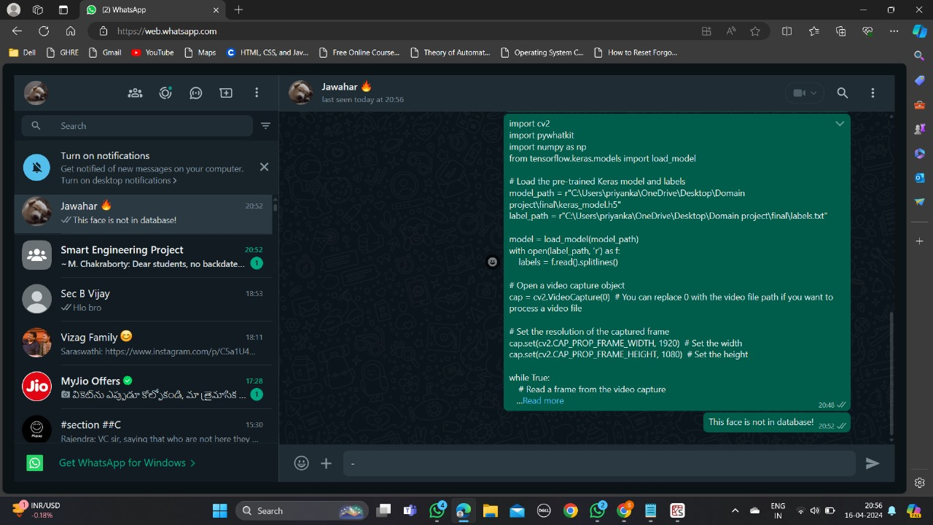
OUTPUT

Slide 10
CONCLUSION
AI-based security alert system has proven to be a highly effective and efficient tool for enhancing security measures in various settings.
The system is able to accurately identify individuals through facial recognition technology and generate real-time alerts based on pre-defined parameters.
This technology has the potential to greatly improve security protocols by providing instant notifications of potential threats allowing for quick action to be taken.

